Slide 1
Generative Adversarial Networks (GANs)

Slide 2
Generative Adversarial Networks
GANs were introduced in a paper by Ian Goodfellow and other researchers at the University of Montreal, including Yoshua Bengio, in 2014.
Generative adversarial networks (GANs) are deep neural net architectures comprised of two nets, pitting one against the other (thus the “adversarial”).
GANs’ potential is huge, because they can learn to mimic any distribution of data. That is, GANs can be taught to create worlds eerily similar to our own in any domain: images, music, speech, prose.

Slide 3
What Are Generative Adversarial Networks?
A Generative Adversarial Network, or GAN, is a type of neural network architecture for generative modeling.
Generative modeling involves using a model to generate new examples that plausibly come from an existing distribution of samples.
Such as generating new photographs that are generally similar but specifically different from a dataset of existing photographs.

Slide 4
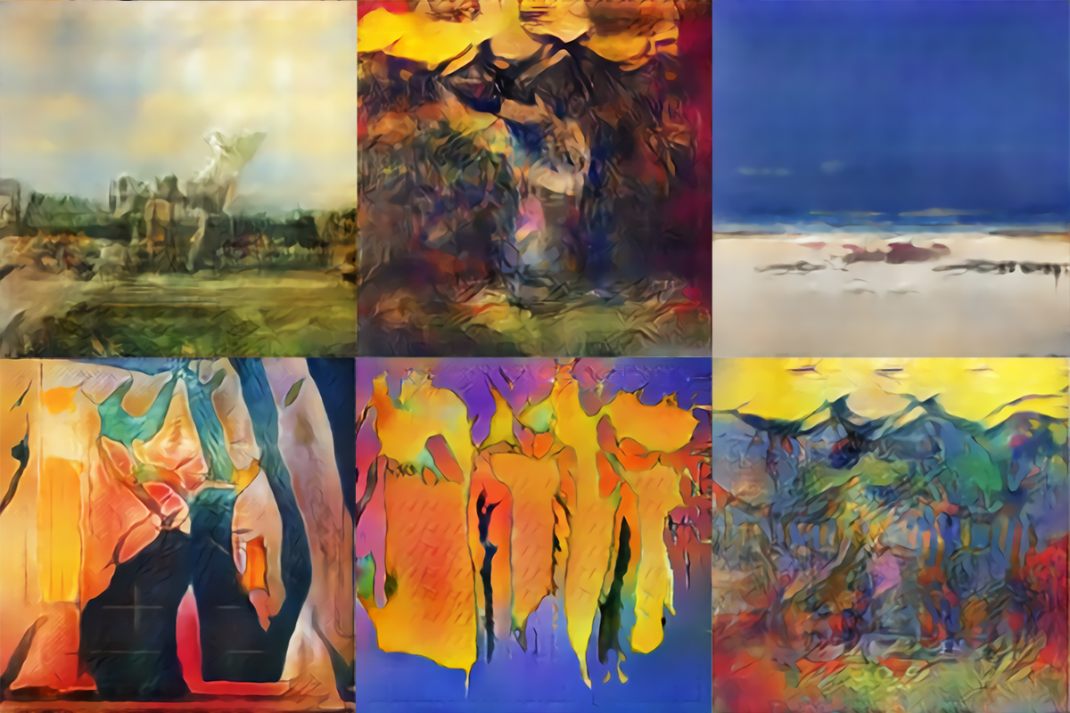
Arts created by GAN

Slide 5
Generator and Discriminator
A GAN is a generative model that is trained using two neural network models. One model is called the “generator” or “generative network” model, which learns to generate new plausible samples.
The other model is called the “discriminator” or “discriminative network” and learns to differentiate generated examples from real examples.
The two models are set up in a contest or a game (in a game theory sense) where the generator model seeks to fool the discriminator model, and the discriminator is provided with both examples of real and generated examples.

Slide 6
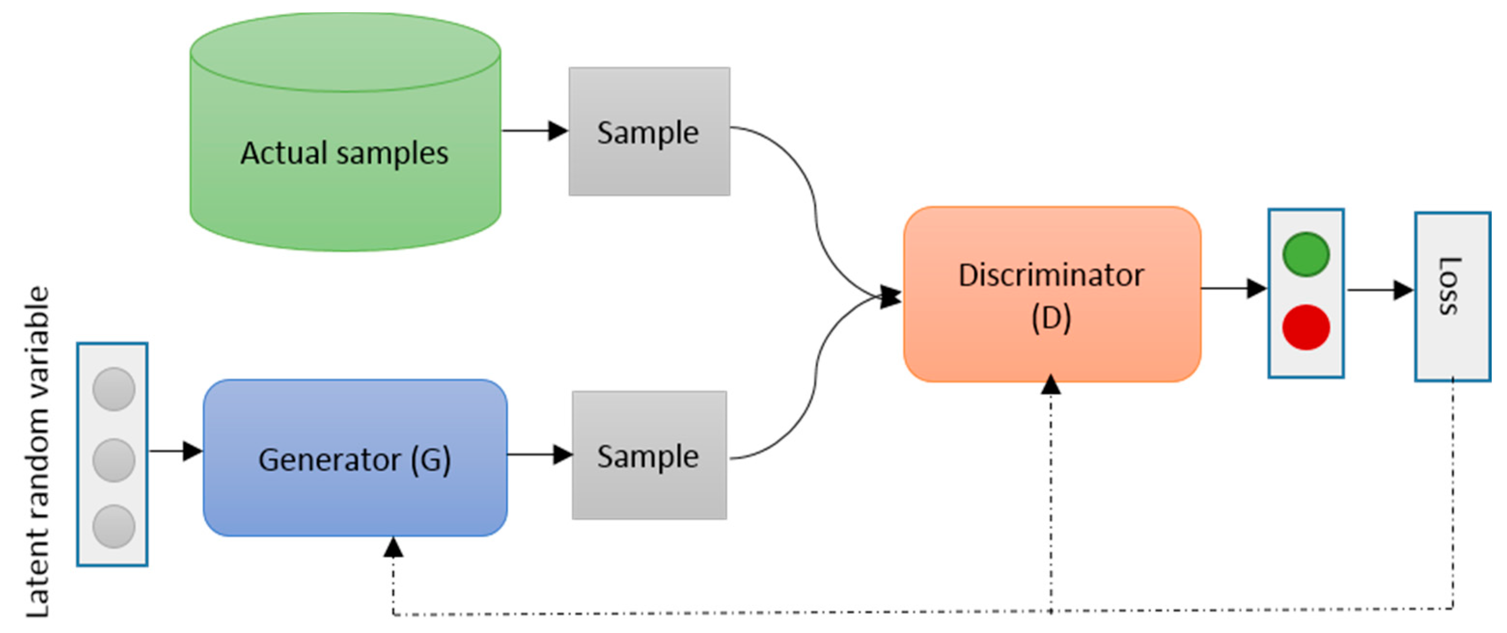
GAN Working

Slide 7
Steps of GAN
The generator takes in random numbers and returns an image.
This generated image is fed into the discriminator alongside a stream of images taken from the actual, ground-truth dataset.
The discriminator takes in both real and fake images and returns probabilities, a number between 0 and 1, with 1 representing a prediction of authenticity and 0 representing fake.

Slide 8
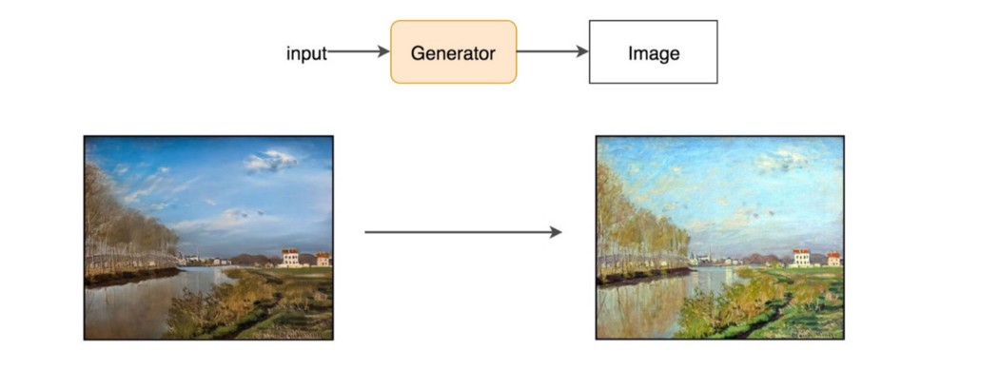
Generator Vs Discriminator
Generator alone will just create random noise.
Conceptually, the discriminator in GAN provides guidance to the generator on what images to create.
By training with real images and generated images, GAN builds a discriminator to learn what features make images real.
Then the same discriminator will provide feedback to the generator to create paintings that look like the real Monet paintings.

Slide 9
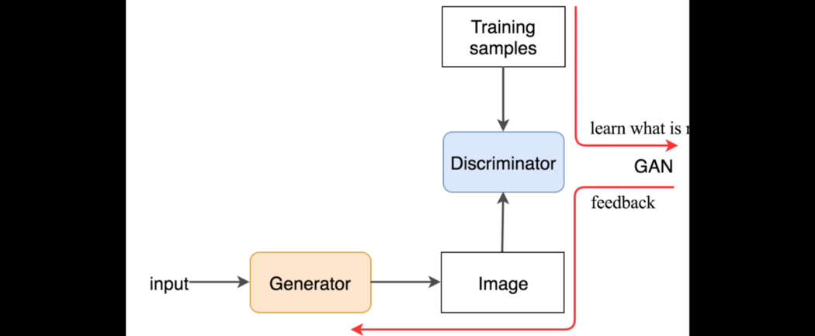
Flow

Slide 10
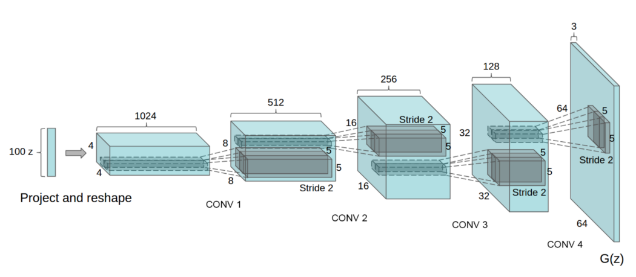
Inverse of CNN
The generator is an inverse convolutional network.
Standard convolutional classifier takes an image and downsamples it to produce a probability.
The generator takes a vector of random noise and upsamples it to an image.
The first throws away data through downsampling techniques like maxpooling, and the second generates new data.

Slide 11
GAN Use Cases
Text to Image Generation
Image to Image Translation
Increasing Image Resolution
Predicting Next Video Frame

Slide 12
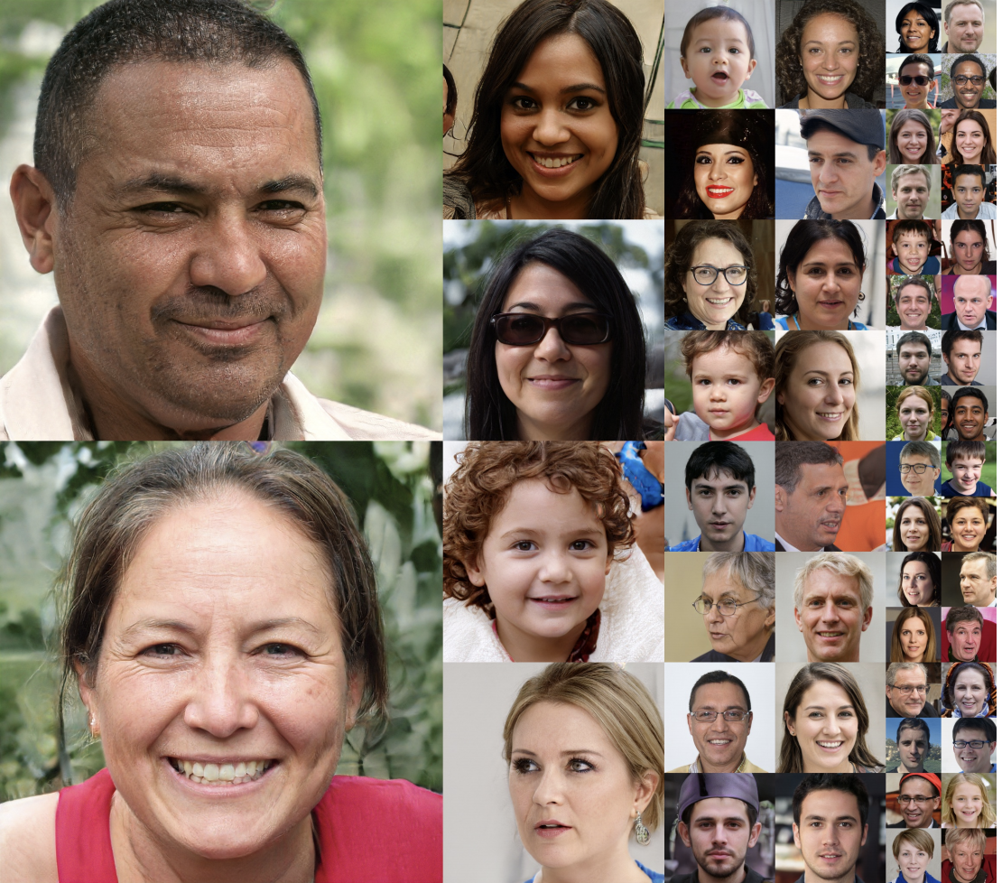
Application

Slide 13
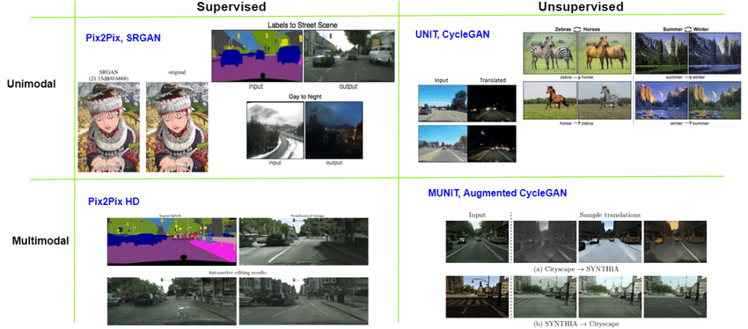
Application

Slide 14
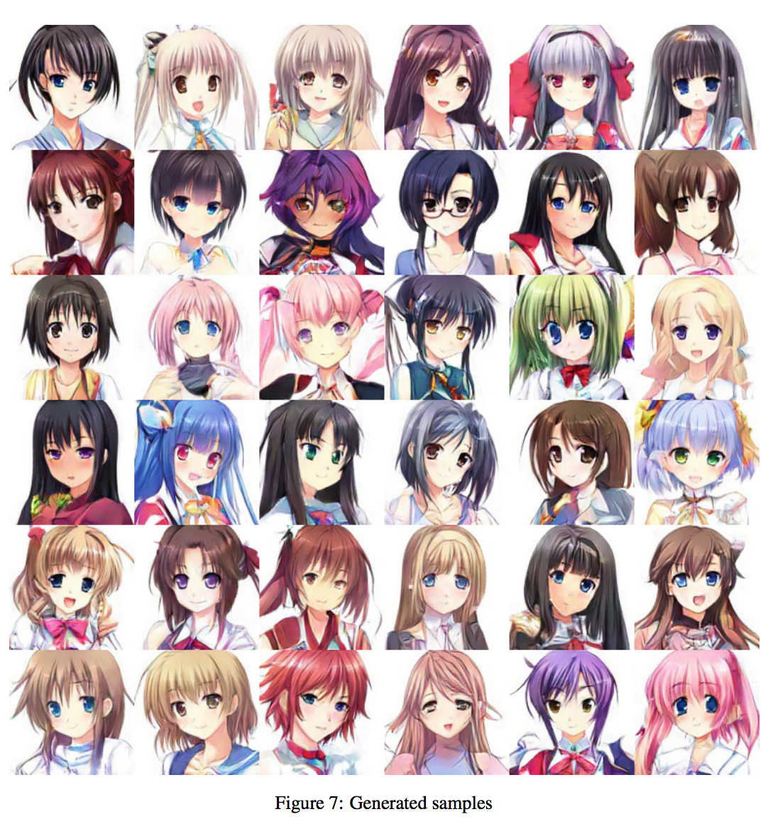
Application

Slide 15
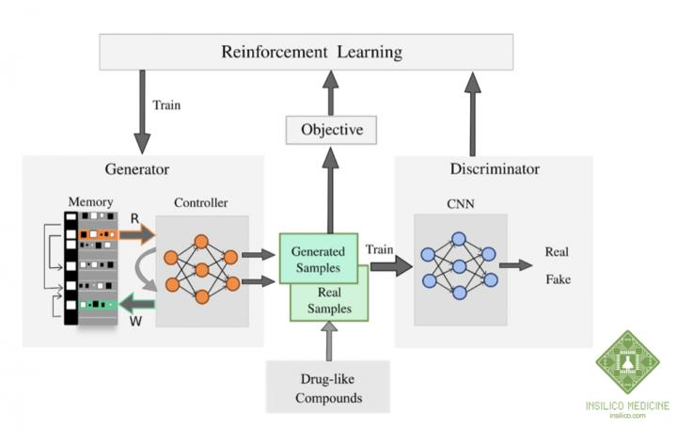
Application

